Slide 1
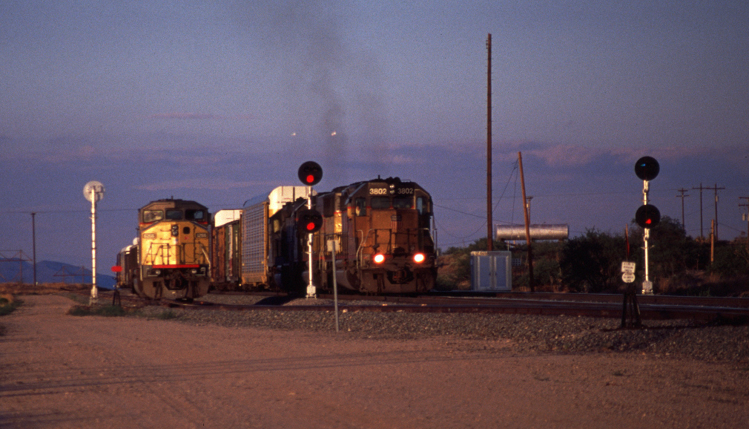
Ghost train passing through Tucson, Arizona

Slide 2
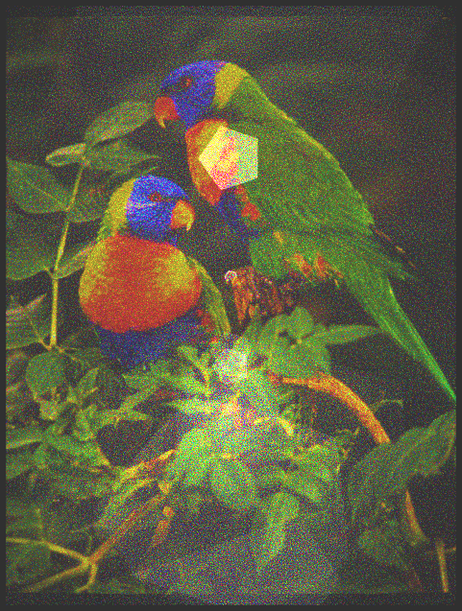

Slide 3
